Slide 1


SAP UI5 & FIORI with OData TRAINING using BAS
Anubhav Oberoy
Day – 7

Slide 2

Agenda – Day 7
Expression Binding
Concept of Named Model
How to create Named Model
Aggregation Binding
Element Binding
Event Object concept

Slide 3
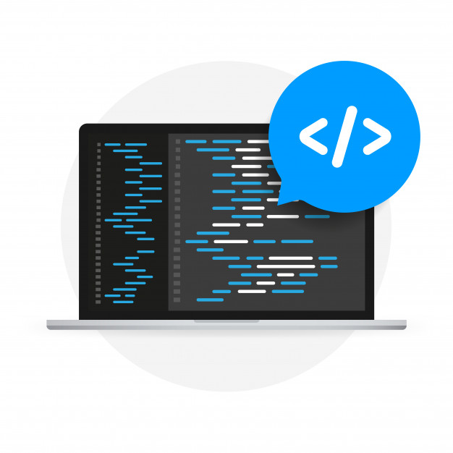
Expression Binding
Expression binding : - When we bind an Expression ({= condition ? true : false}) with the property of a control rather binding value to a property, this is called expression binding.
If we need some calculation on model data or some sort of comparison, then expression binding is useful.
Syntax:
numberState = “{= ${path} > value ? ‘conditionForTrue’ : ‘ConditionForFalse’ }”
Use Case of Expression Binding
My Manager want to add a make salary field grayed(read-only) whenever the employee name is Anubhav.
If The Employee Name is Anubhav, the salary must be 20000.
Condition – if employee name = Anubhav
Outcome – the salary must be 20000
Target – Salary field
Note: To use expression binding in our application we need to add line in the bootstrap code of UI5 in index.html
data-sap-ui-bindingSyntax="complex"

Slide 4
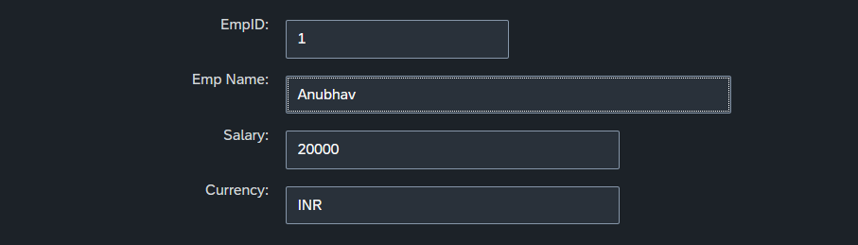
Hands-on : Expression Binding
Do the expression binding according to the use case;
use case - If The Employee Name is Anubhav, the salary must be 20000.
Condition – if employee name = Anubhav
Outcome – the salary must be 20000
Target – Salary field
Code Link:
Main.view.xml

Slide 5
Concept of Named Model
Concept of named model comes into observation when we want to use more than one model simultaneously in one application. When we uses two model simultaneously the there are some conflicts arises in the application , as the second model we use will overwrite the data of the first model. So, here we use the Named Model
Creation of Named Model :
sap.ui.getCore().setModel(oModel2 , “Name of the model”) ;
For example :
sap.ui.getCore().setModel(oModel2 , “thanos”); here thanos is the name of the model
Binding using the Named Model:
So in binding we use this name, to bind the data from the named model we use modelName>path in binding syntax
For example:
“{thanos>/empStr/empName}” this will bind the name from thanos model.

Slide 6
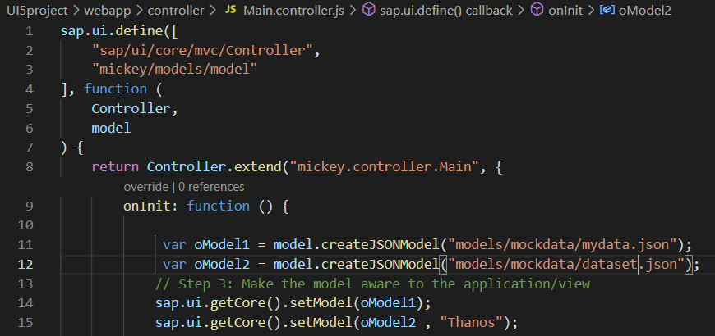
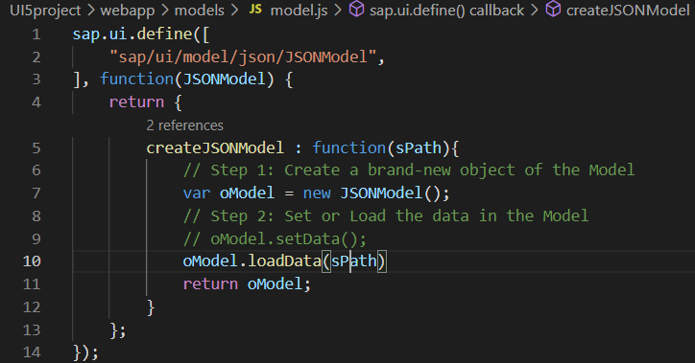
How to create a Named Model
Create a model(dataset.json) in the models folder .
In controller , we have to give the path in the createJSONModel() function
In model.js we have to get the path from the controller and the using that path we have to load the data using loadData() function
To bind the data in view ,so we have to use the name of the named model.

Slide 7
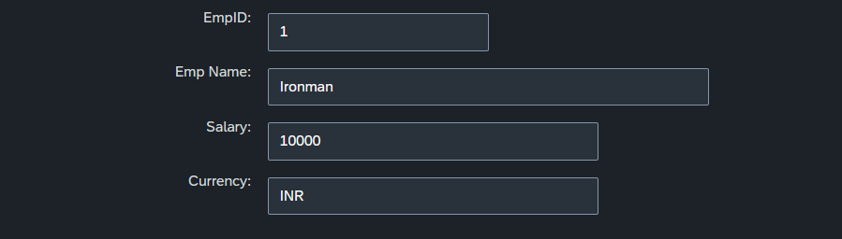
Hands-on : Creation of named model
Create a named model by following the steps of the above slide and bind it to the simpleform.
Code Link:
Main.view.xml
Main.controller.js
dataset.json
Model.js

Slide 8
Aggregation Binding
When we bind the aggregation of a control with the entityset of data model, it is called aggregation Binding.
The parent control (e.g. Table) is bound to the EntitySet path which is called absolute path and the child of the parent Control (e.g. Columns) are connected to the child properties of the EntitySet is called relative path.
In aggregation binding, based on your model data, as many child controls will be created automatically.
Every Event of UI5 will trigger the eventHandler and we will get the Event Object as part of the event Handler. Depending on the event, the event handler object will have different parameters.
Use Case of Aggregation Binding
If we want to show a list or some data in tabular format, we need to bind a group of data. In such a case we will use aggregation binding.
Absolute path
{
“empTab”: [
{
“empId”: 50,
“empName”: “Jay”,
“salary”: 9500
}
]
}
Table = {/empTab}
Emp Id | Emp Name | Salary
{empId} | {empName} | {salary}
Relative Paths

Slide 9
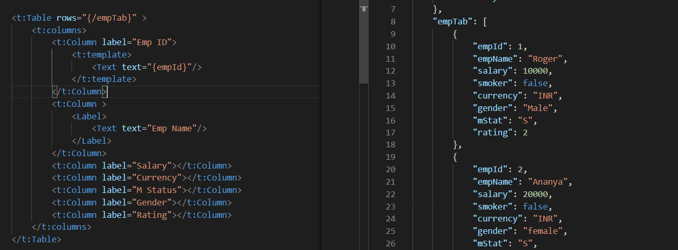
Absolute Path : Connecting parent to parent
Relative Path : connecting child to child respective to parent control

Slide 10
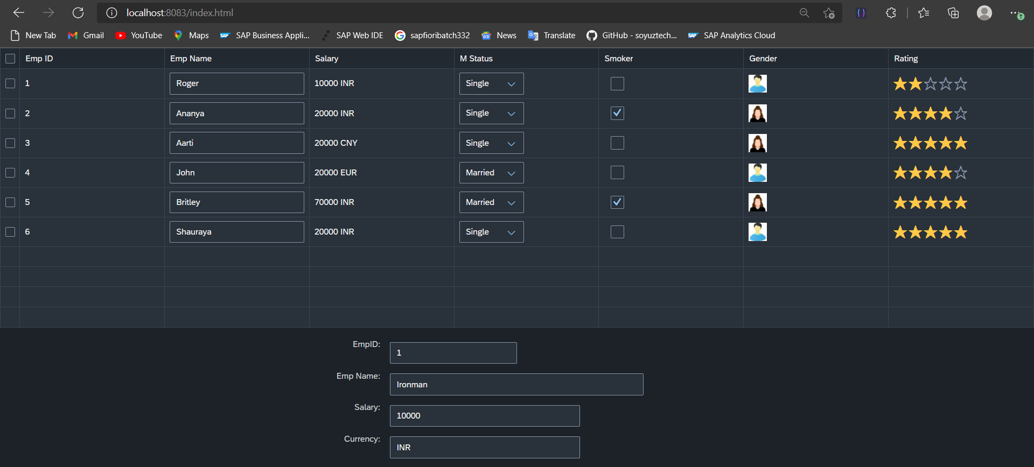
Hands on : Aggregation Binding
Create a SAP UI Table
After creating the table do the aggregation Binding as explained in above slides.
Code Link:
mydata.json
Main.view.xml

Slide 11
Element Binding
To Understand the element binding first we have to understand about the what is element.
Element : Data related to the table inside the model memory is called as element ,
so, if we have 10 elements in the model we will get eventually 10 rows in table at runtime.
“empTab": {
"empId": 1,
"empName": "Roger",
"salary": 10000,
"smoker": false,
"currency": "INR",
"mStat": "S",
"rating": 2
}, ,
{
"empId": 2,
"empName": "Ananya",
"salary": 20000,
"smoker": true,
"currency": "INR",
"mStat": "S",
"rating": 4
}
Id | Name | Salary
1 | Roger | 10000
2 | Ananya | 20000
Element 0
Element 1

Slide 12
Element Binding continues..
Element binding is useful for containers and layouts containing other controls. All these child controls would be required to use properties of the same model object or model node, then element-binding is preferable.
An element to be bound to an object in the Model can be achieved by Element binding.
Use case:- On Select of a row in the table show the row data in a form.
The path of the element will always be the :
/entitysetname/index of the element
Table
Emp Id | Emp Name | Salary
{empId} | {empName} | {salary}
Element 0
/empTab/0
/empTab/1
/empTab/2
Element 1
Element 2
Simple Form
Field 0
/empId
All the content of Row 1 in the table is bind to all the fields in the form
Field 1
/empName
Field 2
/salary

Slide 13

Event Object Concept
Every UI5 event handler method will be entitled to receive an object free in the function, this object is know as event object.
This object is responsible to carry important information about the event.
For example : the rowSelectionChange event’s event object will let you know about the index of the row selected by the user.
Every Event object in SAPUI5 have exact 3 same function which are generic :
getSource() : will give the object of the source control from where event was
originally generated. We can get object of the control, we can use it
without giving an id.
2. getParameters() : every event carries a lot of the information about the user action
e.g. row index of the selected row of the table. All this info come
in form of parameters.
3. getParameter() : if we want to get single parameter value we can get it using this
getParameter() function.
Note : best practice to use event object is put oEvent in the function’s parameter and using a hard debugger and then check the information got by the event object in browser’s console.

Slide 14
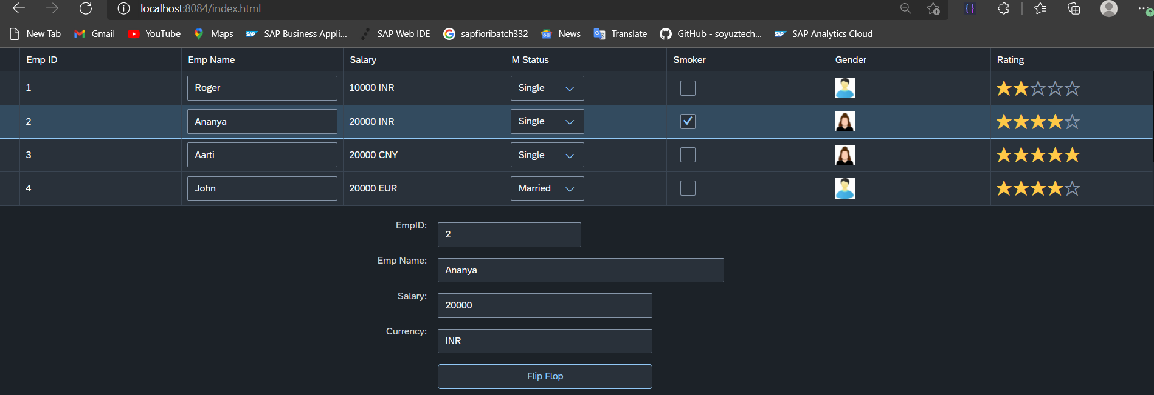
Hands 0n :Element Binding
Make the table rows from multiselect to single select.
Show only 4 rows in the table.
On select one row the data of that row have to shown in the Simpleform by using the event object and element binding discussed in the previous slides.
Create a flipflop button on press of that button the data change in the table and simpleform from named model and on the second click the data from the default model.
Code Link:
Main.view.xml
Main.controller.js
dataset.json

Slide 15

End of Day 7

Slide 16

Questions

Slide 17

Anubhav Oberoy

Slide 18


We’re committed to empower you to be
Most Desirable Resource
through powerful training solutions.
We build the workforce of the future.
250+
Corporate Clients
30,000+
Learners Trained
25000+
Learners Placed
FREE WEBINARS
Sign up for free webinars with industry experts every fortnight!
Enroll Now!
Contact us today!
https://anubhavtrainings.com/

Slide 19




More from AnubhavTrainings.com

Slide 20
Title
Content

